Slide 1

Arithmetic Operators
Four basic operators:
addition: +
subtraction: -
multiplication: *
division: /
Expression: combination of variables, literals, operators, and/or method calls
(a + b) / 2
Parentheses control the order of the computation
(a + b) / 2
Multiplication and division have a higher precedence than addition and subtraction
a + b / 2

Slide 2
Arithmetic Operators
Mixing integers and floating-point values in an arithmetic expression yields a floating-point value
7 + 4.0 is the floating-point value 11.0

Slide 3
Increment and Decrement
The ++ operator adds 1 to a variable (increments)
counter++; // Adds 1 to the variable counter
The -- operator subtracts 1 from the variable (decrements)
counter--; // Subtracts 1 from counter
Figure 1 Incrementing a Variable

Slide 4
Integer Division and Remainder
Division works as you would expect, as long as at least one of the numbers is a floating-point number, that is declared as a double
Example: all of the following evaluate to 1.75
7.0 / 4.0
7 / 4.0
7.0 / 4
If both numbers are integers, the result is an integer. The remainder is discarded
7 / 4 evaluates to 1
Use % operator to get the remainder with (pronounced “modulus”, “modulo”, or “mod”)
7 % 4 is 3

Slide 5

Integer Division and Remainder
To determine the value in dollars and cents of 1729 pennies
Obtain the dollars through an integer division by 100
int dollars = pennies / 100; // Sets dollars to 17
To obtain the remainder, use the % operator
int cents = pennies % 100; // Sets cents to 29
Integer division and the % operator yield the dollar and cent values of a piggybank full of pennies.

Slide 6
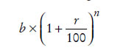
Powers and Roots
Math class contains methods sqrt and pow to compute square roots and powers
To take the square root of a number, use Math.sqrt; for example, Math.sqrt(x)
To compute x^{n}, you write Math.pow(x, n)
To compute x² it is significantly more efficient simply to compute x * x
In Java,
can be represented as
b * Math.pow(1 + r / 100, n)

Slide 7
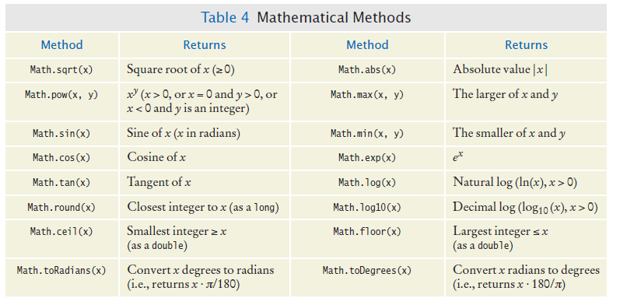
Mathematical Methods
http://docs.oracle.com/javase/8/docs/api/

Slide 8
Converting Floating-Point Numbers to Integers - Cast
The compiler disallows the assignment of a double to an int because it is potentially dangerous
The fractional part is lost
The magnitude may be too large
This is an error
double balance = total + tax;
int dollars = balance; // Error: Cannot assign double to int
Use the cast operator (int) to convert a convert floating-point value to an integer.
double balance = total + tax;
int dollars = (int) balance;
Cast discards fractional part
You use a cast (typeName) to convert a value to a different type.

Slide 9
Converting Floating-Point Numbers to Integers - Rounding
Math.round converts a floating-point number to nearest integer:
int rounded = Math.round(balance);
If balance is 13.75, then rounded is set to 14.

Slide 10
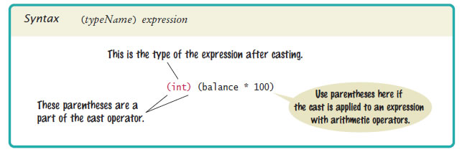
Syntax 4.2 Cast

Slide 11
Self Check 4.7
In Java, how do you compute the side length of a square whose area is stored in the variable area?
Answer:
double sideLength = Math.sqrt(area);

Slide 12
Self Check 4.9
What are the values of 1729 / 100 and 1729 % 100?
Answer: 17 and 29

Slide 13
Self Check 4.10
If n is a positive number, what is (n / 10) % 10?
Answer: It is the second-to-last digit of n. For example, if n is 1729, then n / 10 is 172, and (n / 10) % 10 is 2.

